Slide 1

Ball Sort Puzzle
Heuristic Search Methods for One Player Solitaire Games
Artificial Intelligence
Master in Informatics and Computing Engineering
Gonçalo Alves – up201806451 Gustavo Mendes – up201806078
Pedro Seixas – up201806227

Slide 2
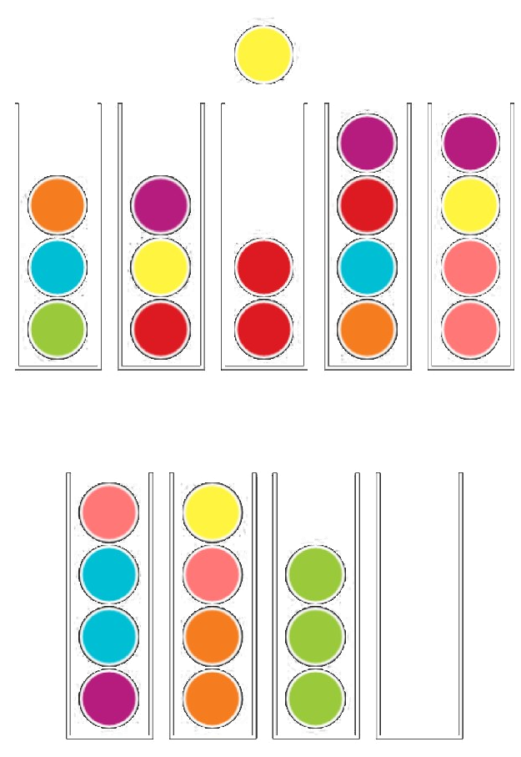

Specification
The objective of the Ball Sort Puzzle is to sort the colored balls in the tubes until all balls with the same color stay in the same tube.
The player can only move a ball at the top of a tube to:
- an empty tube;
- another tube that has a ball with the same color on top and has enough space;
The player can also undo his moves if he finds himself without moves.

Slide 3
Related Work
Link to the Google Play page;
Link of all existing levels;
We used the curricular unit’s presentations to guide our implementation of the various algorithms.

Slide 4
Formulation of the problem as a search problem
State Representation:
- Ball: [1..∞]
Tube: [Ball, Ball, Ball, Ball] or []
Game: [Tube,Tube,…]
Operators:
Move(X,Y):
PreCond: Tube Y must be empty or have a Ball, on top, just like the one that is moved
Effect: move Ball from Tube X to Tube Y
Cost: 1 is the general case, it represents a move; C2, evaluation of the number of wrongly placed Balls, based on the Ball at the bottom of a Tube
Initial State:
Game: [Tube,Tube,…], where every Tube doesn’t contain 4 equal numbers
Objective State:
- Game: [Tube,Tube,…], where every Tube either contains 4 equal numbers or is empty

Slide 5
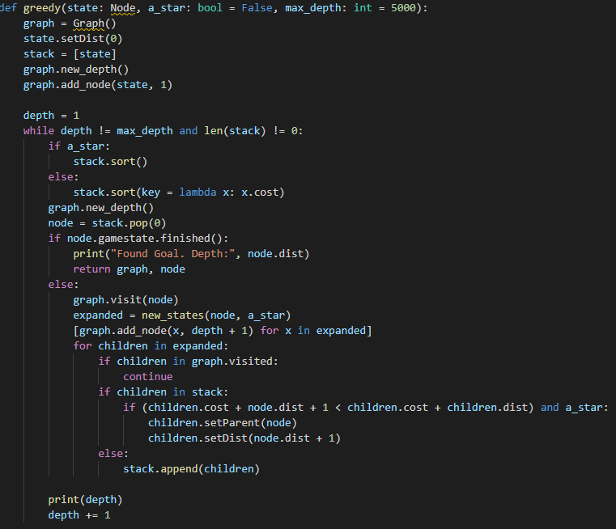
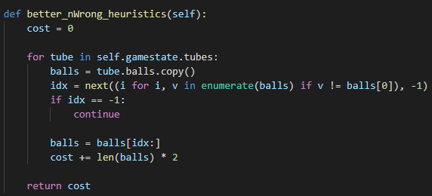
Implemented Heuristics
We have implemented BFS, DFS, IDS, Greedy Search and A*.
Our evaluation function, used in A*, calculates the number of wrongly placed Balls (Balls with diferent color of the Ball at the bottom) in a Tube.
Code:

Slide 6
Implementation work already carried out
Programming language: Python, with visualization using pygame package
Development environment: VSCode/IntelliJ
Data Structures:
Lists, for representing the Tubes and the Game
Nodes and Graphs
File Structure: The Project’s Repository is available at Github
Implemented Work: All algorithms lectured; Graphical Interface, playable game with hints

